Slide 1
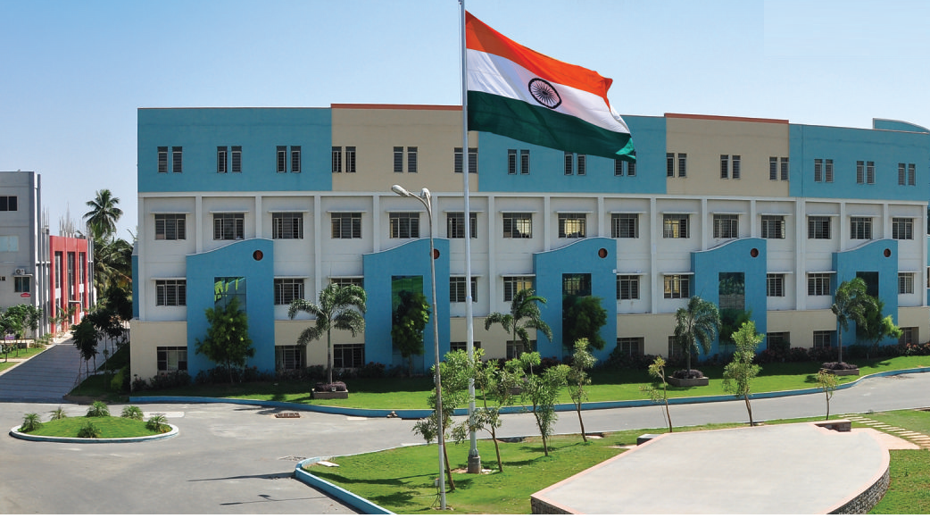
SRI ESHWAR COLLEGE OF ENGINEERING academic year: 2017-18 department: CIVIL section: FINAL YEAR
DESIGN PROJECT REVIEW –1
Date of review: 02.08.2017

Slide 2
Planning, Analyzing & Designing of SEIBS
Batch Members
1. Kartick M
2. Krishna Kumar D
3. Rubini K
4. Vigenesh N
Guide Name
Mr. Siva K P
Asst.Prof/Civil Dept.

Slide 3
Presentation Outline
Abstract
Introduction
Literature Survey
List of figures
Need for the study

Slide 4
Abstract of the project
In order to promote our players and to develop our institution with a better sporting culture, it is very important to provide a better circumstances that should be irrespective of the surroundings and weather conditions.
As a result to this, an attempt is made to plan, analyse and design an Indoor Basketball Stadium in our college campus.
The stadium consists of standard Basketball court included with audience gallery, player dressing rooms, and rest room.
This stadium covers an area of about 21420 sq ft. The basic planning will be done by AutoCAD and analysing of the structure is carried out by STAAD Pro.
The designing of the structure is carried out by limit state method with IS 456:2000 & IS 800:2007 code book specifications.
Loading conditions are referred in IS 875 Part 1-3 & 4. Designing of the structure will be done by Revit Architecture.

Slide 5
Introduction
A structure refers to a system of two or more connected parts used to support a load. It is an assemblage of two or more components connected to each other so that they serve the user and carry the loads developing due to the self and super-imposed loads safely without causing any serviceability failure.
The attempt comprises of making a PLANNING ANALYSIS AND DESIGNING OF INDOOR BASKETBALL STADIUM and manually.
The proposed building consists of G+1 of plinth area 21420 sq.m.
The building consists of 4 players room, 3 VIP rooms ,8 rest rooms commentary room,video room.
Thus we have provided all the adequate features to our maximum level required for a standard commerical building.
GROUND FLOOR
The plinth area of ground floor is 21420 Sq.m
FIRST FLOOR
The plinth area of first floor is 21420 sq.m

Slide 6
OBJECTIVE OF THE PROJECT
To have a comprehensive application of the subject studied under the course.
To make detailed structural analysis.
To have good possibility for analysing different plans and also chance for studying greater of planning.
Since all the above three aims are fulfilled under title “PLANNING ANALYIS AND DESIGNING OF INDOOR BASKET BALL STADIUM”and the same is selected.

Slide 7
Scope
Since there is only one indoor basket ball stadium available in coimbatore, this will add even more value to the game.

Slide 8
Methodology
We are using AUTOCAD software for planning and STADD.pro software for analysis.
We are using Limit State Method of Design for designing of footing and plinth beam using IS456-2000.
IS800-Steel Designing
IS875(part-1)-Dead load
IS5875(part-2)-Live load

Slide 9
Literature Survey (Cont’d..)
JOURNAL | International Journal of Steel Structures, Vol 10, Issue3 pg 253-265 September(2011)
TITLE | Fracture Behaviour Analysis of welded Beam to Column Connections Based on Elastic and Inelastic Fracture Mechanism
AUTHOR(S) | Yuanqing Wang, Hui Zhou
INFERENCE | The analysis have confirmed the observations from connection cyclic tests that the fracture is most likely to occur at the beam flange weld heat affected zone which sustains extensive yielding and exhibits relatively low fracture toughness

Slide 10
Literature Survey (Cont’d..)
JOURNAL | International Journal of Steel Structures, Vol 10, Issue3 pg 47-55 September(2009)
TITLE | DESIGN AND RESEARCH ON COMPOSITE STEEL AND CONCRETE FRAME-CORE WALL STRUCTURE
AUTHOR(S) | Hou Guangyu , Chen Binlei
INFERENCE | In order to improve the ductility, bearing capacity of the core walls and to ensure inelastic deformation capacity of the longitudinal coupling beams carried steel trusses, proper steel frames were embedded within the longitudinal core walls.

Slide 11
Literature Survey (Cont’d..)
JOURNAL | International Journal of Engineering Research and Applications, Vol 4, Issue 4 pg 9-12 April(2014)
TITLE | Planning and analysis of an Arched Indoor Stadium
AUTHOR(S) | Alice TV, Harishankar S
INFERENCE | It deals with planning and designing of a multilevel indoor stadium with hanging table tennis court and Olympic Standard level swimming pool and it also compares between arched structure and plane frame structure

Slide 12
Literature Survey (Cont’d..)
JOURNAL | International Journal of Steel Structures, Vol 11, Issue 2 pg 203-213 June(2011)
TITLE | Analysis on Shear Behaviour of High-Strength bolts Connection
AUTHOR(S) | Yuanqing shi, Meng Wang
INFERENCE | It gives a simple process to provide quite accurate results, which provides a great tool for engineering applications

Slide 13
Literature Survey (Cont’d..)
JOURNAL | International Journal of Steel Structures, Vol 13, Issue 2 pg 209-218 June(2013)
TITLE | Experimental and Numerical Investigations of High Strength Steel Welded H-Section Columns
AUTHOR(S) | Feng Zhou, Yiyi Chen
INFERENCE | It reports experimental and numerical investigations of High strength steel columns. It shows accurate predictions of the experimental ultimate loads and failure modes of the test specimen

Slide 14
Literature Survey (Cont’d..)
JOURNAL | International Journal of Steel Structures, Vol 13, Issue 3 pg 385-399 September(2013)
TITLE | Shear Buckling Characteristics of cold-formed Steel Channel Beams
AUTHOR(S) | Poologanathan, Mahendran
INFERENCE | Improved equation for the higher elastic shear buckling coefficients of LCB was proposed based on FEA results and included in the ultimate shear capacity equations

Slide 15
Literature Survey (Cont’d..)
JOURNAL | International Journal of Steel Structures, Vol 13, Issue 4 pg 635-644 December(2013)
TITLE | Effect of End distance and Bolt Number on Bearing Strength of Bolted Connections at Elevated Temperature
AUTHOR(S) | Kuo chen yang, Rejia hsu
INFERENCE | To avoid the failure at the bolted connections and ensure fire resistance at elevated temperature, this study examines the effect from experimental results. Performed to evaluate stress distribution at bolt hole with varied end distance and temperature levels.

Slide 16
Literature Survey (Cont’d..)
JOURNAL | International Journal of Steel Structures, Vol 17, Issue 1 pg 273-289 (2017)
TITLE | Investigation on the Weld Damage Behavior of Steel Beam to Column Connection
AUTHOR(S) | Xiong, YJ shi
INFERENCE | This study provides technical basis for the damage evaluation and fracture prevention of the welded steel beam to column connections

Slide 17
Literature Survey (Cont’d..)
JOURNAL | International Journal of Steel Structures, Vol 15, Issue 2 pg 375-2387 (2015)
TITLE | Seismic Axial Loads In Steel Moment Resisting Frames
AUTHOR(S) | Jay Shen, Onur Seker
INFERENCE | This study focuses on exploring the seismic axial loads for columns in SMRFs under strong ground motions

Slide 18
Literature Survey (Cont’d..)
JOURNAL | International Journal of Steel Structures, Vol 16, Issue 3 pg 719-733 (2016)
TITLE | Experimental Model of the Behavior of Bolted Angles Connections with Stiffeners
AUTHOR(S) | Mahyar Maali, Mahmut kihe
INFERENCE | The main parameters observed are the evolution of the resistance, the stiffness, the rotation capacity, the ductility of a joint, and the energy dissipation capacity

Slide 19
Need for the study
To build an indoor stadium in our campus and to promote sports activities.
To give an indoor stadium irrespective of weather conditions.
To promote our players with good playing circumstance and exposure.

Slide 20
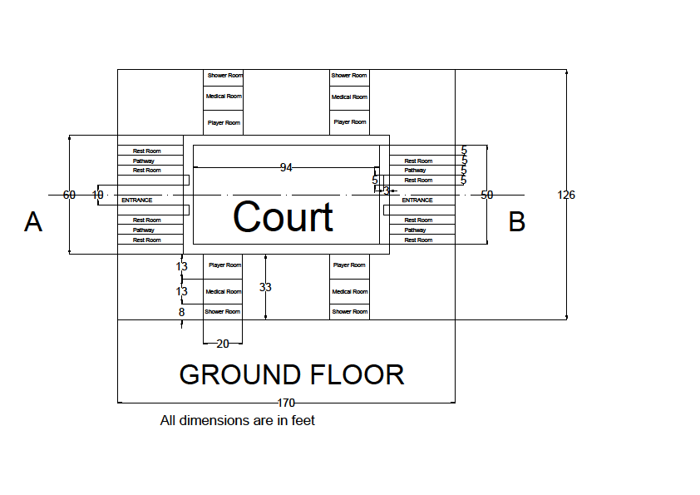
Ground floor plan

Slide 21
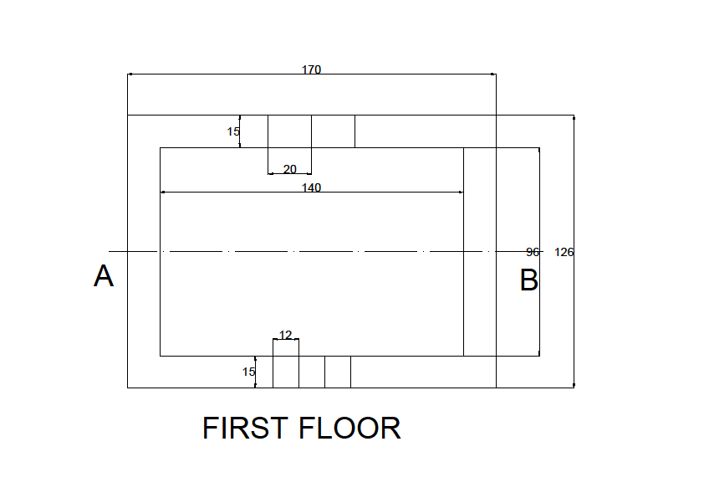
First floor plan

Slide 22
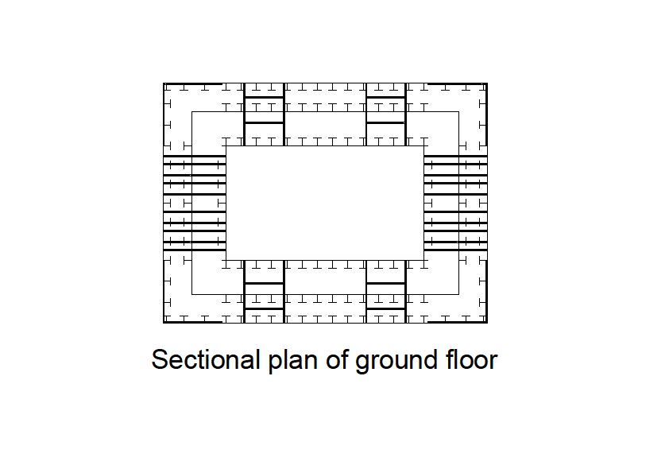
Ground floor section

Slide 23
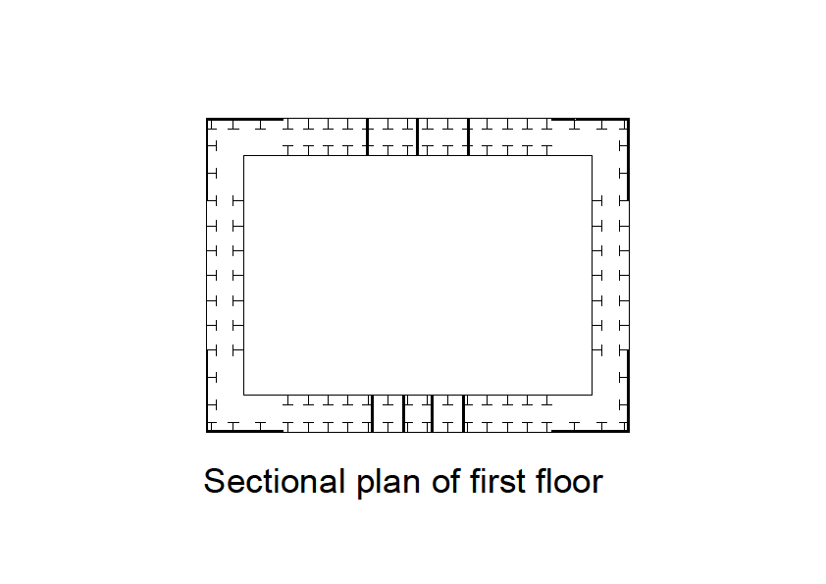
1st floor section

Slide 24
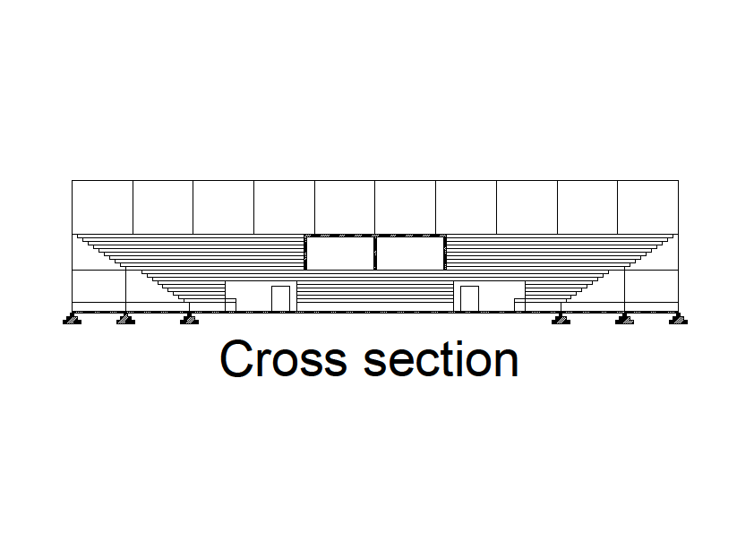
Sectional view

Slide 25
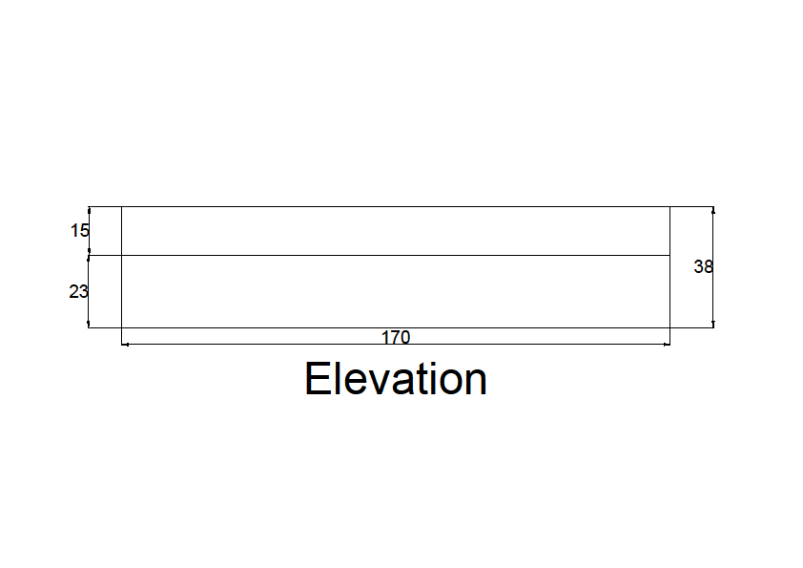
Elevation

Slide 26
Work Schedule
S.NO | DATE | WORK TO BE DONE | REMARKS
0 | 08.07.2017 | Selection of Topic
1 | 18.07.2017 | Collection of literatures
2 | 03.08.2017 | Planning
3 | 13.08.2017 | Analyzing
4 | 25.08.2017 | Designing
5 | 30.08.2017 | Generation of Reports
6 | 10.09.2017 | Preparation of book
7 | 20.09.2017 | Submission of book

Slide 27
Textbooks
1. Gambhir. M.L., "Fundamentals of Structural Steel Design", McGraw Hill Education India Pvt. Ltd., 2013
2. Shiyekar. M.R., "Limit State Design in Structural Steel", Prentice Hall of India Pvt . Ltd, Learning Pvt. Ltd., 2nd Edition, 2013.
3. Subramanian . N, "Design of Steel Structures", Oxford University Press, New Delhi, 2013.

Slide 28
REFERENCE
1. Narayanan.R.et.al. "Teaching Resource on Structural Steel Design", INSDAG, Ministry of Steel Publications, 2002
2. Duggal. S.K, "Limit State Design of Steel Structures", Tata McGraw Hill Publishing Company, 2005
3. Bhavikatti.S.S, "Design of Steel Structures" By Limit State Method as per IS:800–2007, IK International Publishing House Pvt. Ltd., 2009
4. Shah.V.L. and Veena Gore, "Limit State Design of Steel Structures", IS 800–2007 Structures Publications, 2009.
5. IS800 :2007, General Construction In Steel - Code of Practice, (Third Revision), Bureau of Indian Standards, New Delhi, 2007

Slide 29
Queries?

